Slide 1
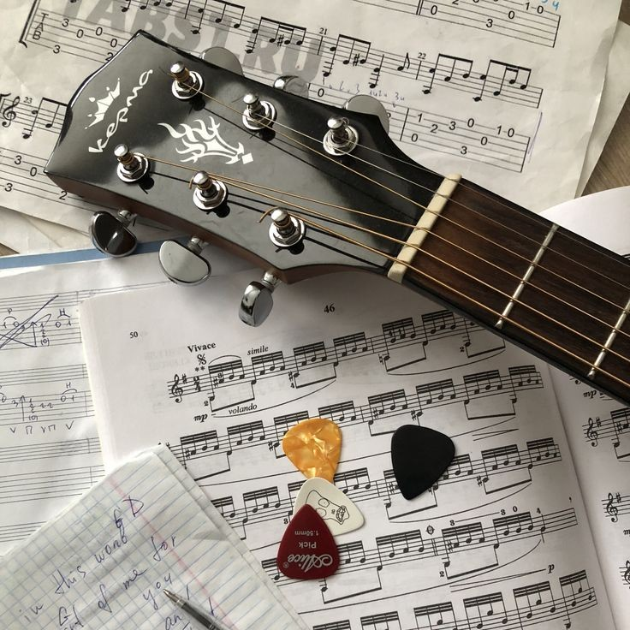
Final Presentation
Guitar
Coach
CSE 115A
03.18.2026
Jackson Earl - Product Owner
Erin Eagleson
Kailyn Le
Joonhee Han

Slide 2

A Brief Introduction
MOTIVATION FOR OUR PROJECT
Learning guitar is a difficult and strenuous task
Pick up the guitar → play the song(s) you know → skills plateau
With tailored recommendations and helpful feedback,
guitarists of all levels continue to grow

Slide 3
Goals
Set out to Achieve
Have Achieved
– Spotify integration for personalized song recommendations
– Skill assessment via questionnaire
– AI-generated practice plan tailored for a specific song
– Progress tracking to encourage motivation
– Audio upload feature for personalized playing feedback (stretch goal)
– Song recommendations with OpenAI & Spotify
– 10-question skill questionnaire saved into supabase
– 7-day AI-generated practice plans
- saveable, loadable, with detailed tasks
– Task completion tracked through supabase
– Overall progress displayed with the use of a radar chart in the Progress page

Slide 4
Biggest Challenges
Regarding Final Product
Spotify OAuth complexity
Token storage, refresh logic, and the redirect callback took far longer than estimated — this cost most of week one in Sprint 2.
OpenAI JSON reliability
Despite explicit prompt instructions, the model occasionally returned malformed JSON, requiring error handling on every recommendation and practice plan call.
Task and overall progress tracking
It was difficult finding an effective way to track the user’s overall progress given the variety of tasks OpenAI outputted.

Slide 5
Biggest Challenges
Regarding Development Process
Underestimating backend complexity
Our burnup charts showed the same pattern every sprint: flat in week one, steep in week two. We consistently underestimated how long backend integration tasks would take.
New stack, everyone learning at once
None of us had worked with React/TypeScript, FastAPI, Supabase, and two external APIs together before. Sprint 1 was slower than planned because of this.

Slide 6
System Screenshots/Video/Live demo

Slide 7
System overview/diagram
User (Browser)
React Frontend (TypeScript)
Supabase
(Auth + DB)
FastAPI Backend
(Python)
OpenAI GPT-4o-mini
Spotify Web API

Slide 8
Technologies you used and what you used them for
React + TypeScript
Supabase
Spotify Web API
Frontend. TypeScript gave us type safety across all components and caught integration mismatches early. It was especially useful when wiring the Spotify and OpenAI responses into state.
Authentication, session management, and PostgreSQL database. Handled everything from user sign-up and Spotify token storage to practice plan persistence and task completion records.
Fetches the user's top tracks, top artists, and recently played data. This listening history is the core input for personalizing recommendations.
FastAPI (Python)
OpenAI GPT-4o-mini
Vitest
Backend API server. Lightweight and easy to modularize: separate routers for Spotify auth, recommendation logic, and practice plan generation kept the codebase clean as it grew.
Powers both song recommendations and 7-day practice plan generation. Prompt-engineered to return structured JSON with consistent fields every call, with error handling for edge cases.
Unit testing framework. We wrote tests for the skill scoring utility that maps questionnaire answers to 7 weighted skill categories. These caught real edge cases before they reached the UI.

Slide 9
Project management techniques you used
How we ran Scrum
– 4 two-week sprints with defined goals, user stories, and story point estimates using planning poker
– 3 meetings per week: TA meeting Wednesday, team Thursday, Sunday check-in
– Rotating Scrum Master: Joonhee led Sprints 1 and 4, Erin led Sprints 2 and 3
– End-of-sprint reports with stop/start/continue retrospectives
– Scrum board on GitHub Projects, maintained throughout all four sprints
Additions and deviations
– Texting the group chat before starting work to avoid conflicts
– Submitting a PR before merging to avoid merge conflicts
– The team contract (TAC): agreeing on meeting times, communication norms, being helpful and kind
– Using Messages for day-to-day communication
– Using GitHub Projects to track tasks

Slide 10
Things you…
ENJOYED :)
DIDN’T ENJOY :(
– Building something that actually works end to end. Spotify connects, AI recommends, plans generate. That's not trivial to pull off in ten weeks.
– The AI integration. Getting the OpenAI prompts to return consistent, useful JSON every time was genuinely satisfying to figure out.
– How the team handled disagreements. People were willing to explain their reasoning and change their minds when someone made a good point.
– Seeing the skill radar chart populate from questionnaire answers for the first time.
– Debugging Spotify OAuth. Token expiry edge cases, redirect URI mismatches, and CORS issues consumed most of week one in Sprint 2.
– The slow-start pattern on every sprint. Feeling behind in week one was stressful, but definitely completely predictable and avoidable.
– Scope creep. Features that felt small during planning (skill-to-exercise mapping) turned out to be significantly larger than estimated.
– Hard-coded localhost API URLs that had to be manually found and updated across every frontend file.

Slide 11
Lessons Learned
What worked/ What you will keep doing
PR reviews before merging: they caught real bugs and kept the main branch stable throughout the project.
Frequent short meetings over infrequent long ones: knowing we'd sync in two days made it easier to surface blockers quickly.
What didn’t work/ What you stop doing
Building UI before the backend it depends on is stable
Treating API integration tasks as small during planning
  OAuth flows and external API wiring always take longer than they look.
Letting carryover stories sit at the bottom of the board
  they need to be addressed first, not last.

Slide 12
Lessons Learned
Things you wishes you had done
(that you would start doing in the future)
Write unit tests and incorporating style guides
Break backend tasks into smaller milestones with clear acceptance criteria during sprint planning, not just hour estimates.
Set environment variables for API base URLs on day one so the codebase is deployment-ready from the start.

Slide 13

THANK YOU
Created by: GuitarCoach Team

